Slide 1
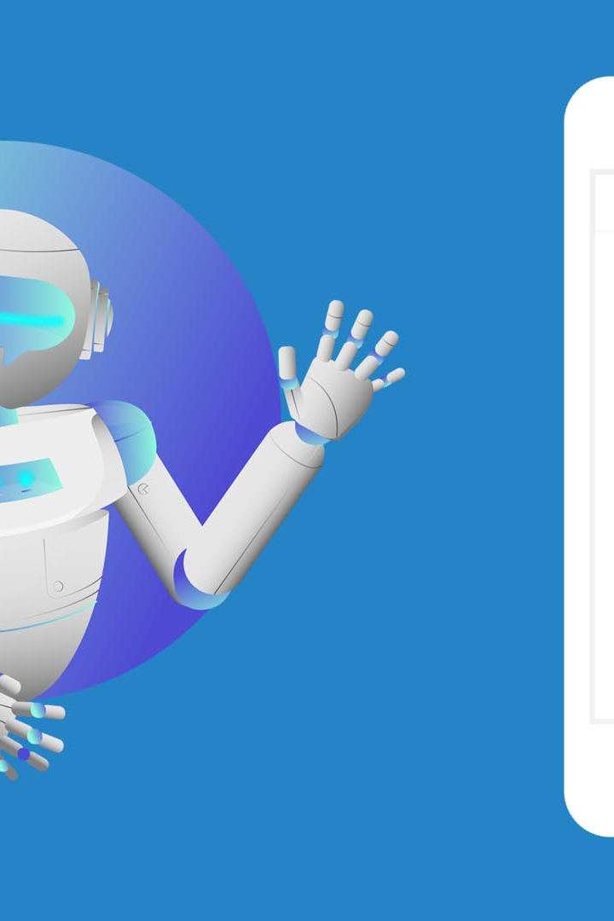
Chatbot Using NLP
Discovering the power of chatbots and Natural Language Processing (NLP) technology in creating conversational AI experiences that are truly intelligent and engaging.
By : Ambedkar
Pradeep
Rohan Kumar

Slide 2

What is a Chatbot?
A chatbot is a computer program designed to simulate human-like conversations. Unlike humans, chatbots are available 24/7, can handle multiple conversations simultaneously, and provide instant responses.

Slide 3

Why Use NLP for Chatbots?
NLP enables chatbots to understand and interpret human language, allowing them to comprehend user intents, extract meaning from text input, and generate appropriate responses. This makes interactions with chatbots more natural and effective.

Slide 4

NLP Techniques for Chatbot Development
1
Intent Recognition
2
Entity Extraction
Use machine learning algorithms to identify the purpose or intention behind user queries, enabling accurate response generation.
Extract specific pieces of information from user messages, such as names, dates, locations, and more, to provide personalized responses.
3
Sentiment Analysis
Analyze the sentiment of user input to gauge emotions and tailor chatbot responses accordingly, ensuring empathetic interactions.

Slide 5
Data Preprocessing for Chatbot Training
1
Data Collection
Collect diverse and representative datasets for training the chatbot, including real user conversations and annotated chat logs.
  Cleaning and Normalization
2
Preprocess the collected data by removing noise, such as special characters, emojis, and URLs, and normalizing text to a standard format.
3
Tokenization and Lemmatization
Segment sentences into individual words or tokens and reduce them to their base or root forms, improving chatbot understanding.

Slide 6
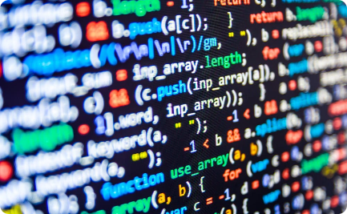
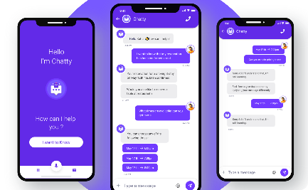
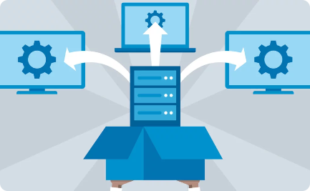
Building a Chatbot Using NLP
Programming
User Interface
Deployment
Use programming languages like Python and libraries such as TensorFlow or PyTorch to implement NLP models, train the chatbot, and deploy it.
Design an intuitive and visually appealing interface to enhance chatbot interactions and improve user experience.
Host the chatbot on a server to make it accessible online, ensuring it can handle user requests in real time.

Slide 7
Evaluating and Improving Chatbot Performance
Accuracy Assessment
User Feedback
Continuous Learning
Measure the accuracy of the chatbot's responses by comparing them against human-generated answers to assess performance.
Solicit user feedback through surveys or feedback forms to understand their satisfaction levels and gather insights for improvement.
Implement mechanisms for the chatbot to learn and improve over time, incorporating user feedback and updating the underlying NLP models.

Slide 8
Future Trends in Chatbot Technology
1
Voice Activation
Chatbots will become more voice-activated, allowing users to interact through speech, enabling hands-free and convenient conversations.
Emotional Intelligence
2
Chatbots will develop emotional intelligence, understanding and responding to users' emotions, creating more personalized and empathetic interactions.
3
Multi-Language Support
Chatbots will be able to communicate and understand multiple languages, facilitating global and multilingual conversations.

